Slide 1

Housing Affordability
Melbourne

Slide 2

Objective: Analyze the factors affecting Housing Affordability in Melbourne
Table of contents:
Factors affecting :
Population-Presenter Hansen
Salary-Aria
School Ranking-Rakhi
Inflation/Interest Rates-Mark

Slide 3
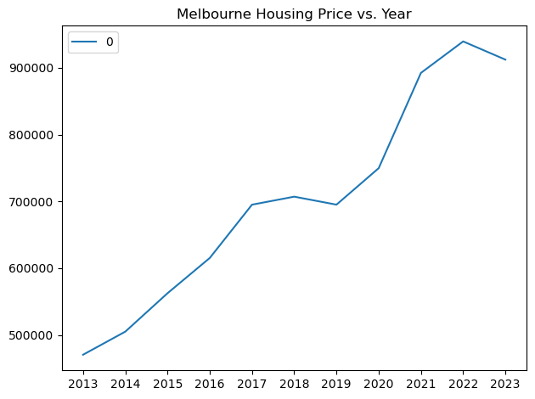
We have decided to concentrate on house prices in the whole of Melbourne from 2013 to 2023.
As per Aria’s Analysis on the Price changes in house prices in Melbourne, there is a clear upward trend as the years go on.
This is an average of the price changes of Melbourne as a whole.
https://www.land.vic.gov.au/valuations/resources-and-reports/property-sales-statistics

Slide 4
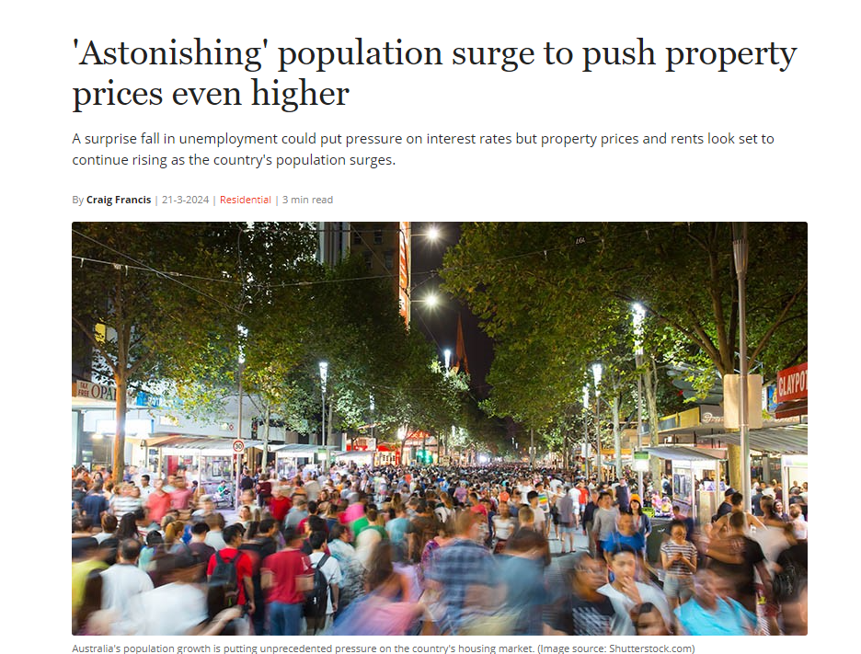
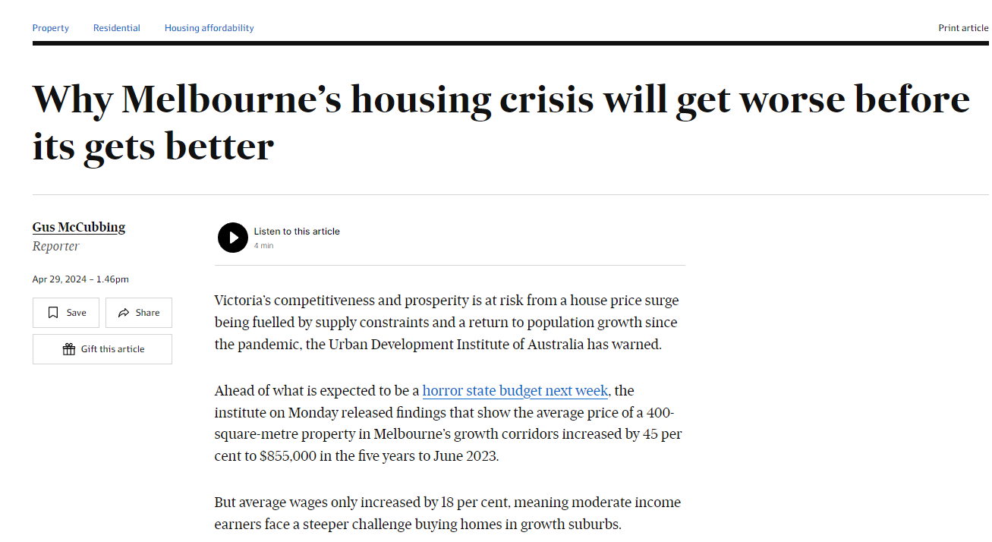
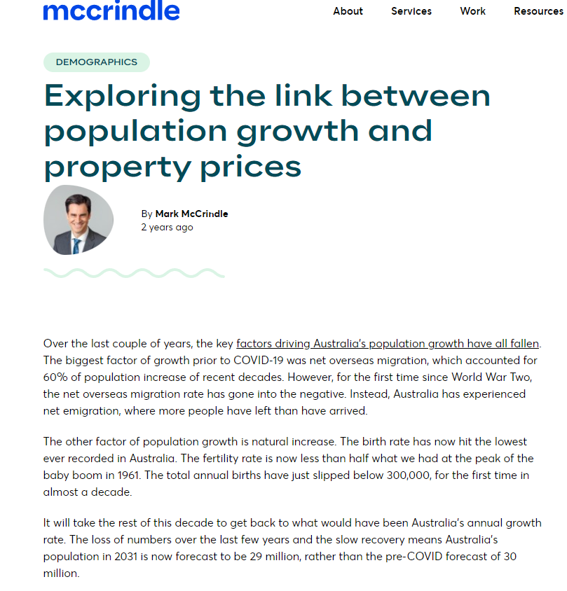
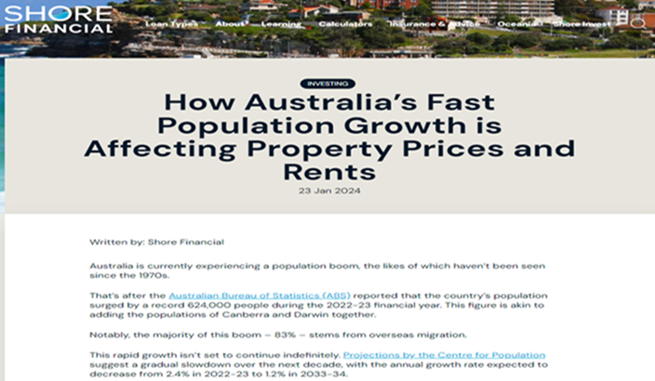
Population – Presenter Hansen

Slide 5
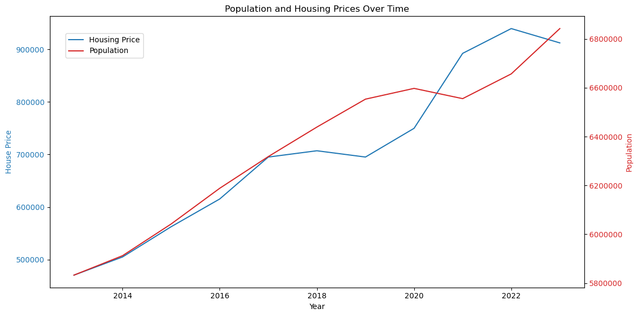
Analysis of Population growth as a factor to rising Housing Prices
The first factor we are going to attend to is the growth of population vs the price of housing.
Melbourne’s population growth stems from overseas migration, interstate relocation and natural growth.
As population grows, the demand for housing grows which in turn increases the price of housing.
The high Pearson correlation coefficient indicates that as the estimated population in Victoria increases, Melbourne housing prices also increase. This suggests a strong relationship between population growth and housing prices. The very low P-values from both the correlation test and the t-test indicate that these findings are highly unlikely to be due to random chance. This gives us confidence that the observed relationship between population and housing prices is real and significant.

Slide 6
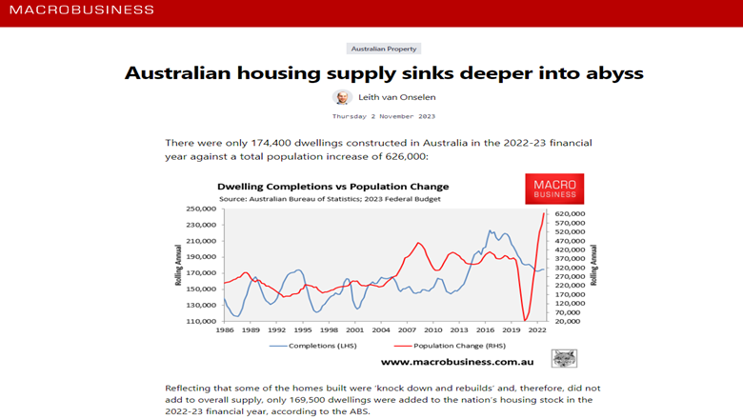

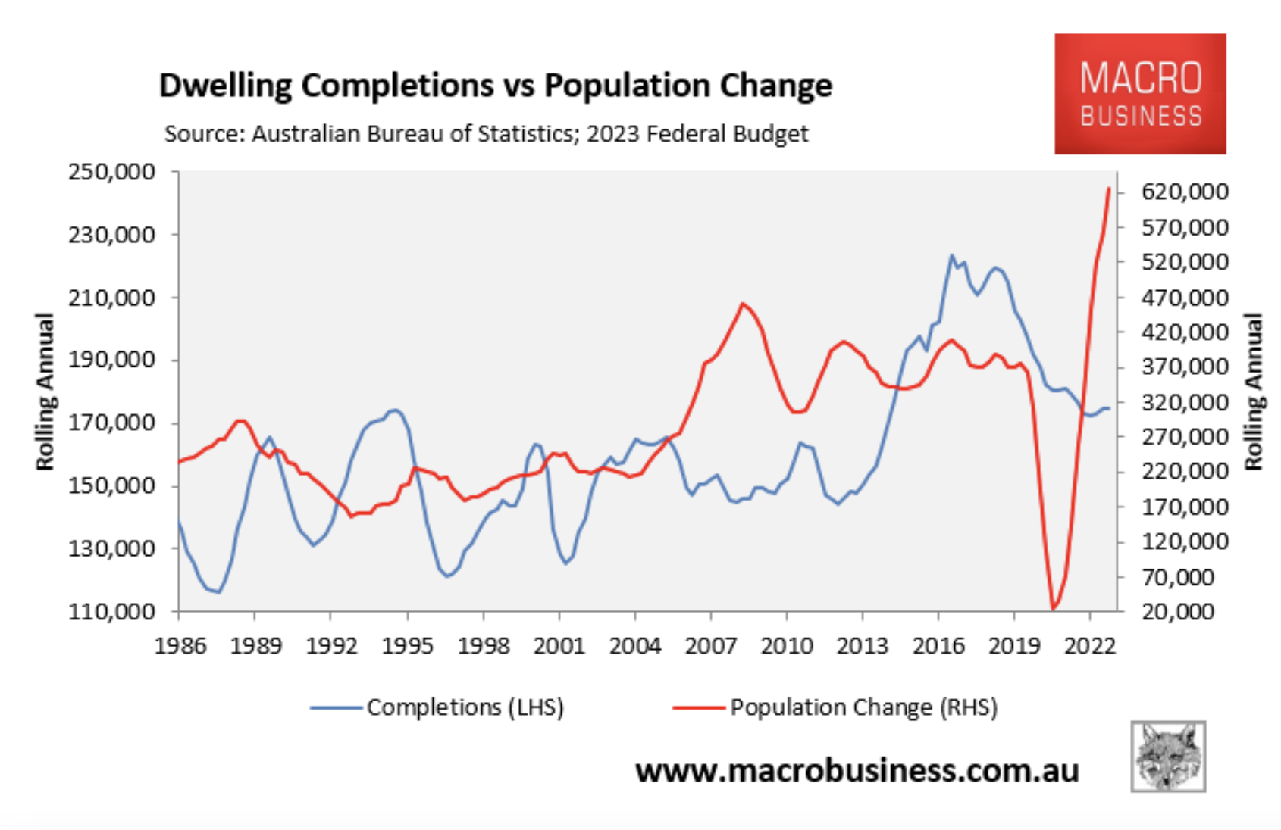
https://www.macrobusiness.com.au/2023/11/australian-housing-supply-sinks-deeper-into-abyss/
To support my analysis, I have added articles from several websites that have their own analysis of Population growth and Property Prices.
In this article, they show that one of their crucial factors exacerbating the situation is that Australia’s population has been growing faster than the country’s housing supply with only 174,400 dwellings constructed in the 2022-23 financial year.
This imbalance between demand and supply has been a key driver of escalating property prices.

Slide 7
Sources for Hansen
Victoria Population Link
https://www.abs.gov.au/statistics/people/population/national-state-and-territory-population/latest-release
https://www.apimagazine.com.au/news/article/astonishing-population-surge-to-push-property-prices-even-higher
https://www.afr.com/property/residential/why-melbourne-s-housing-crisis-will-get-worse-before-its-gets-better-20240429-p5fn9h#:~:text=The%20report%20found%20that%20while,)%2C%20according%20to%20the%20UDIA.
https://mccrindle.com.au/article/topic/demographics/exploring-the-link-between-population-growth-and-property-prices/
https://shorefinancial.com.au/how-australias-fast-population-growth-is-affecting-property-prices-and-rents/

